Slide 1
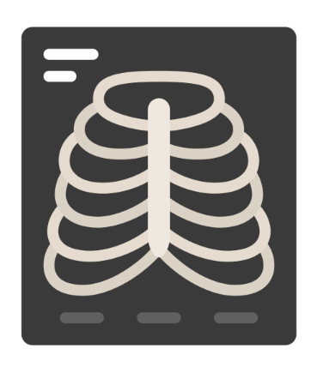


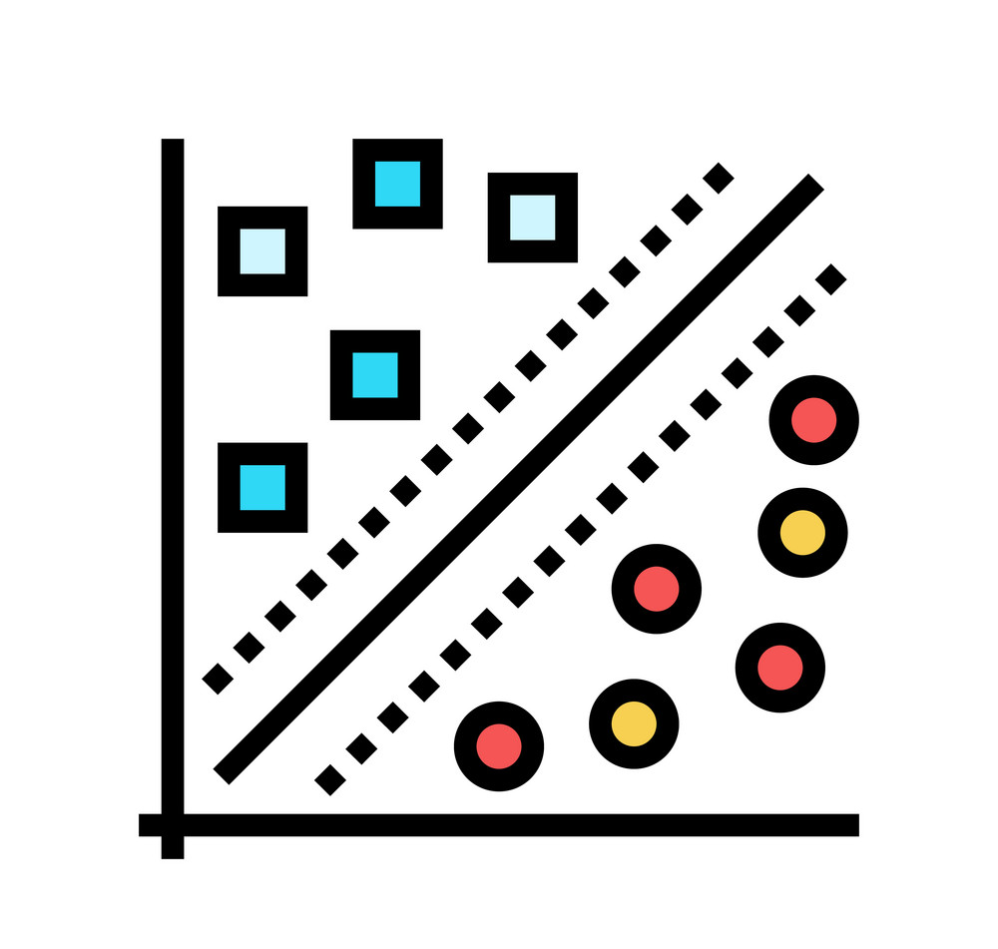


Comparative Analysis of SVM, CNN, and XGBoost
For Binary and Multi-Class Medical Image Classification on Chest X-ray and Brain Tumor Datasets

Slide 2
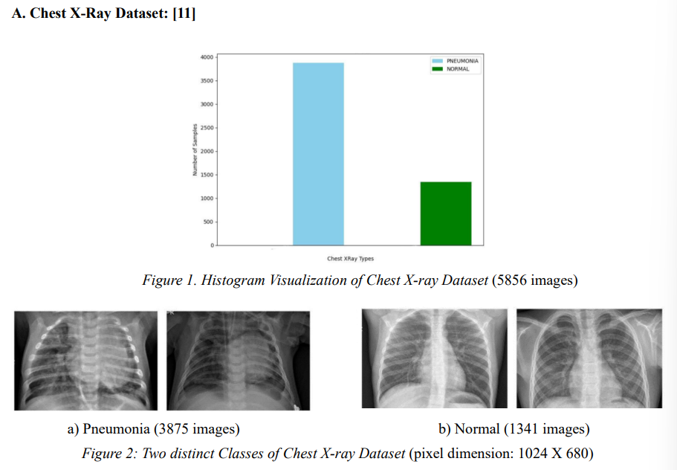
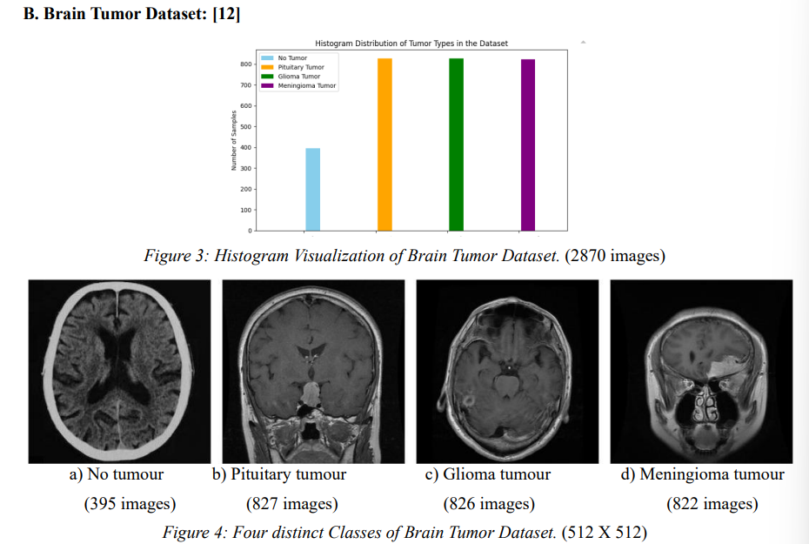
Datasets Used:
Each image has a resolution of 2,000 pixels in width and height, stored as 8-bit grayscale JPEG files.

Slide 3
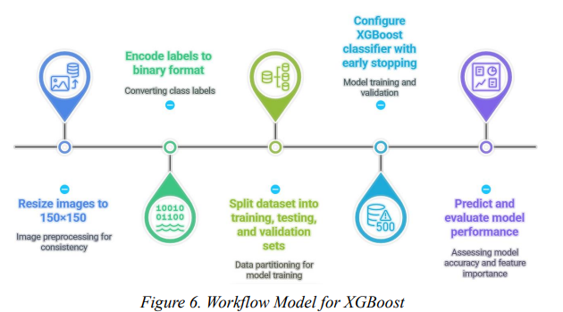
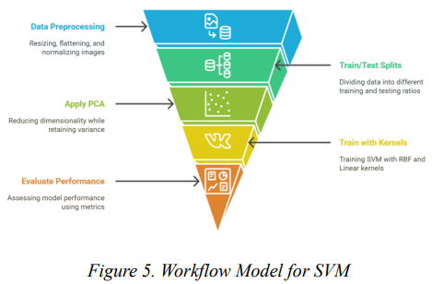
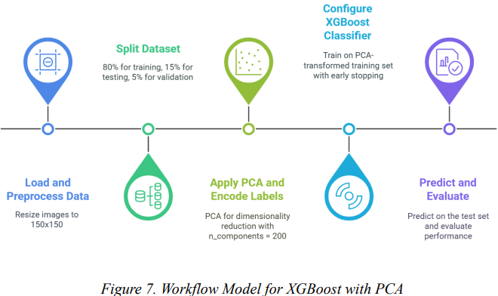
Standalone ML
I. SVM with PCA
II. Raw XGBoost
III. XGBoost with PCA

Slide 4
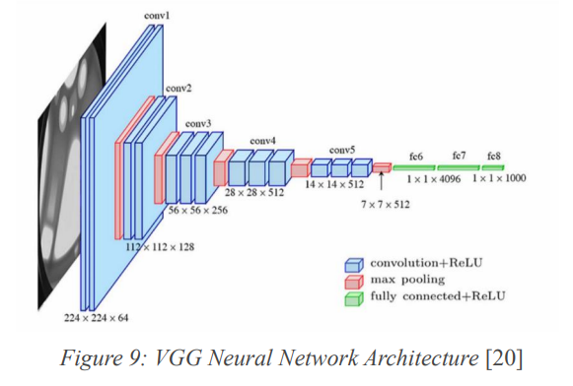
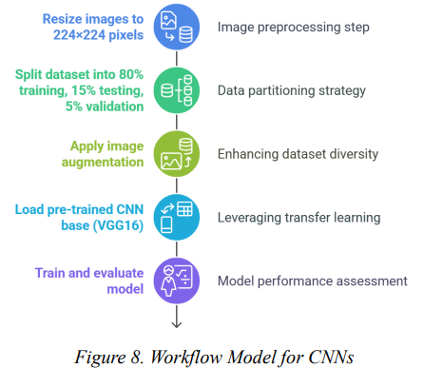
B. Standalone DL - CNNs
VGG16 is a deep convolutional neural network (CNN) architecture developed by the Visual Geometry Group at the University of Oxford; the “16” in its name refers to its 16 weight layers, which include 13 convolutional layers and 3 fully connected layers, making it one of the most influential models in image recognition and classification.

Slide 5
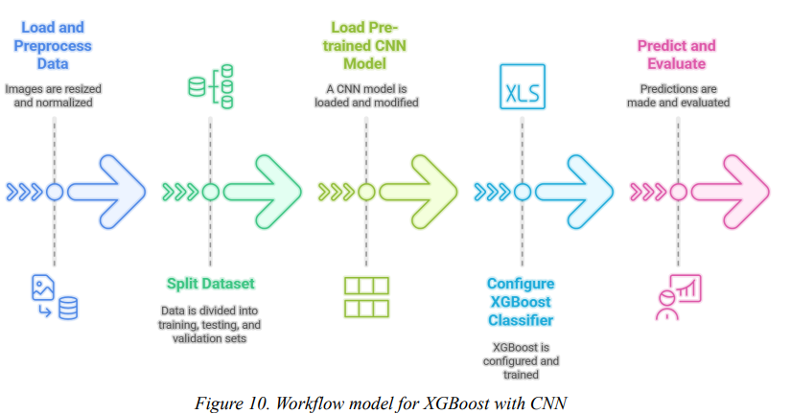
C. Hybrid ML and DL – XGBoost + CNNs
This hybrid approach combines CNN-based feature extraction with XGBoost classification. A pre-trained CNN model, such as VGG16, is first used to extract high-level feature representations from chest X-ray images.
Instead of using the CNN for final classification, the output feature maps from its final convolutional layer are flattened into one-dimensional vectors.
These vectors are then used as inputs for an XGBoost classifier.

Slide 6
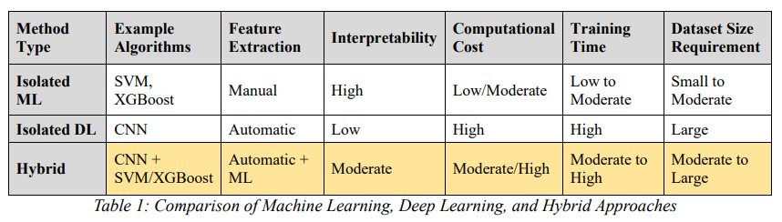
SVM (with and without PCA) performed acceptably when trained on 80% of data (83% test accuracy) but experienced steep declines as the training fraction fell.
Transfer learning CNNs based on VGG16 maintained high accuracy (94% at 80% train and 90% at 20% train) and stable ROC-AUC (>0.90) across all splits, showing effective generalization. The last approach using VGG16 and
XGBoost delivered the best performance (test accuracies of 96% in Brain MRI and 95% in chest X-ray) at all training splits. Moreover, its log-loss and error rates exhibited minimal sensitivity to reduced training size. These results prove that deep, pretrained feature representations offer the most effective solution for medical image classification when labelled data is limited.

